Slide 1
HOMEWORK 6 Due 5/8 00:00 send to e3

Slide 2
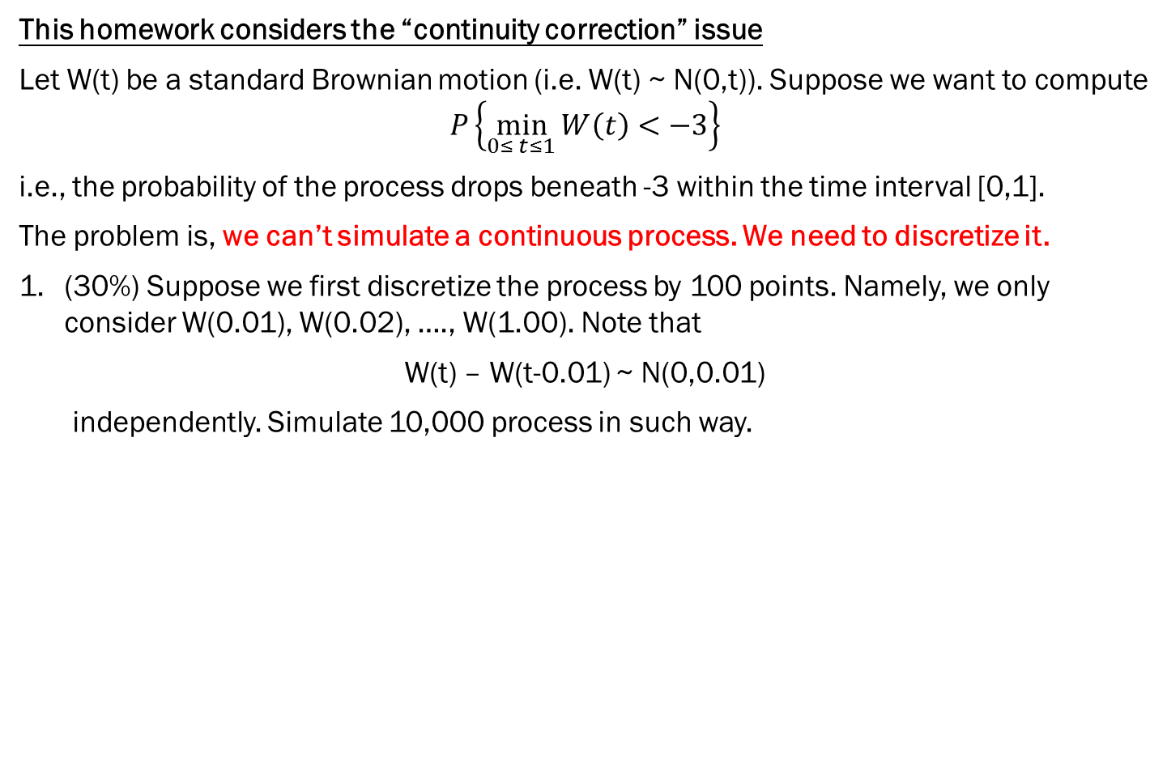
This homework considers the “continuity correction” issue
Let W(t) be a standard Brownian motion (i.e. W(t) ~ N(0,t)). Suppose we want to compute
$$P\left\{\min_{0≤ t≤1}{W\left(t\right)<−3}\right\}$$
i.e., the probability of the process drops beneath -3 within the time interval [0,1].
The problem is, we can’t simulate a continuous process. We need to discretize it.
(30%) Suppose we first discretize the process by 100 points. Namely, we only consider W(0.01), W(0.02), …., W(1.00). Note that
W(t) – W(t-0.01) ~ N(0,0.01)
independently. Simulate 10,000 process in such way.

Slide 3

This homework considers the “continuity correction” issue
(30%) Using the data you simulate in 1., we approximate $P\left\{\min_{0≤ t≤1}{W\left(t\right)<−3}\right\}$ by
$$P\left\{\min_{0≤k≤100}{W\left(0.01k\right)<−3}\right\}$$
Do you think this value is larger, equal to, or smaller than $P\left\{\min_{0≤ t≤1}{W\left(t\right)<−3}\right\}$ ?
(40%) Repeat 1. and 2. by cutting [0,1] into 10,000 points instead. Does your resulting probability increases or decreases?

